Slide 1
Phase Equilibrium Calculations
At VLE, the phase equilibrium equation
or
Bubble Point Calculation
Dew Point Calculation
Flash Calculation

Slide 2
Example: Bubble Pressure Calculation
This computation is given T and xi to calculate P and yi
For an ideal mixture (ideal vapor and liquid)
i = 1,2,3…n (1)
The computation algorithm
The sum of Equation (1) will yield P since all x’s and vapor pressures
are known
2) Back substitution of P into Eq (1) will give all y’s

Slide 3
The Cubic Equations of State
van der Waals
Redlich-Kwong
(All EOS are not completely given)
Soave
Peng-Robinson
Where: a is extractive parameter
b is covolume parameter. when v = b, at infinitive pressure.

Slide 4
Two alternative forms of the R-K and the P-R EOS
(R-K EOS)
Two-parameter EOS
and
Three-parameter EOS
(P-R EOS)

Slide 5
The Virial Equation of State
Equation of state for the association of vapor molecules
The Hayden-O’connell model and the Nothnagel model are the modelsincorporates the chemical theory of dimerization to account for strong association and solvation effects, such as those found in organic acids, like acetic acid.
Please refer to literature for the theoretical considerations.
Usually, every simulation software has these two models for vapor phase calculations.

Slide 6
PC-SAFT EOS (Perturbed Chain Statistical Associating Fluid Theory)
In the PC-SAFT model, a molecule is modeled as a chain molecule by a series of freely-jointed tangent spheres. The contribution from hard-chain fluids as a reference system consists of two parts, a nonbonding contribution (i.e., hard sphere mixtures prior to bonding to form chains) and a bonding contribution due to chain formation (hard chain fluid = hard sphere + chain) (contribution)
The copolymer PC-SAFT model is based on the perturbation theory. This model divides the intermolecular forces into repulsive and attractive contributions and uses a hard-chain reference system to account for the repulsive interactions. The attractive forces are further divided into different contributions, including dispersion, polar, and association
The copolymer PC-SAFT represents the completed PC-SAFT EOS model developed by Sadowski and co-workers (2001 and then). Unlike the PC-SAFT EOS model in Aspen Plus, the copolymer PC-SAFT includes the association and polar terms and does not apply mixing rules to calculate the copolymer parameters from its segments. Its applicability covers fluid systems from small to large molecules, including normal fluids, water, alcohols, and ketones, polymers and copolymers and their mixtures.
.

Slide 7
The Mixing Rules
1) Conventional type
The van der Waals one-fluid theory
(combining rule)
The van Laar mixing rule
The Redlich-Kister type mixing rule (Adachi and Sugie (1986))
2) Local composition type
The Huron-Vidal mixing rule
The Wong-Sandler mixing rule

Slide 8
The Solution Models
The most simple equation that satisfies boundary conditions
The Margules equation:

Slide 9
The Van Laar Model
Pros and Cons:
1. Simple,
2. Suitable to VLE and LLE3.
3. Less accurate for dilute and non-ideal solution.

Slide 10
The Wilson Equation (local composition model)
v_{i}, v_{j}: molar volumes of pure i and j at T
Pros and Cons:
1. Based on local composition consideration.
2. Suitable for non-ideal solution with polar components.
3. Suitable for dilute solution.
4. Not suitable for LLE and VLLE.

Slide 11
The NRTL (Nonrandom Two Liquid) Equation
Pros and Cons
1. Based on local composition, liquid cell theory, and statistic considerations.
2. Suitable for non-ideal solution with polar components.
3. Suitable for VLE, LLE, and VLLE.

Slide 12
The UNIQUAC (Universal Quasi-Chemical ) Equation
Where the combinatorial part considers the nonideal effect caused by molecular size, shape (generating S ), and the residual part considers that by the molecular interaction (generating H )
E
E
Pros and Cons:
1. Suitable for VLE, LLE, and VLLE.
2. Suitable for non-ideal solution with large difference in molecular sizes of constituent components.
3. More accurate extrapolation results than other models since the interaction parameters are less temperature dependent.
4. Model is more complicate.

Slide 13
The UNIFAC Activity Coefficient Equation
The UNIFAC (Uniquac Functional-group Activity Coefficient) Equation was developed from UNIQUAC by considering the effect of functional group on the non-ideality of a mixture.
Pros and Cons:
1. Based on group contribution consideration, less rigorous theoretical considerations.
2. Experimental data are unnecessary for parameter correlation.
3. Suitable for VLE, LLE, and VLLE.
4. Less accurate than other models

Slide 14
COSMO-SAC (Conductor-like Screening Model-Segment Activity Coefficient)
The Cosmo-SAC is a solvation model based on Cosmo-RS (real-solution) that describes the electric fields on the molecular surface of species that are polarizable. It requires a fairly complicated quantum mechanical calculation, but this calculation must be done only once for a particular molecule; then the results can be stored. In its final form, it uses individual atoms as the building blocks for predicting phase equilibria instead of functional groups. Thus, it does not require binary parameters.
This model formulation provides a considerably larger range of applicability than group-contribution methods.
The calculation for liquid non-ideality is only slightly more computationally intensive than activity-coefficient models such as NRTL or UNIQUAC.
1). A. Klamt, "Conductor-like Screening Model for Real Solvents: A New Approach to the Quantitative Calculation of Solvation Phenomena," J. Phys. Chem. 99, 2224 (1995).(Cosmo-RS)
2). S.-T. Lin and S. I. Sandler, "A Priori Phase Equilibrium Prediction from a Segment Contribution Solvation Model," Ind. Eng. Chem. Res. 41, 899 (2002) (Cosmo-SAC).

Slide 15
Correlation of VLE Data
Correlation is an optimization process to determine the model
parameters which minimize the difference between the calculated
and the experimental thermodynamic property It can be expressed as
Min Obj. Func. =
Min
Where
and
is in the form of a solution model
which containing parameters determined from minimizing the objective
function shown above.

Slide 16
Prediction of VLE Behavior
Prediction calculates the thermodynamic properties with the
pre-determined parameters from either experiment or literature.
Through prediction, a vast phase equilibrium data are estimated and the huge laborious experiment work that needs time and effort is avoided

Slide 17
Liquid-Liquid equilibrium
At liquid-liquid equilibrium
Thus,

Slide 18
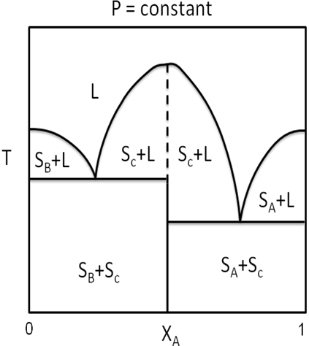
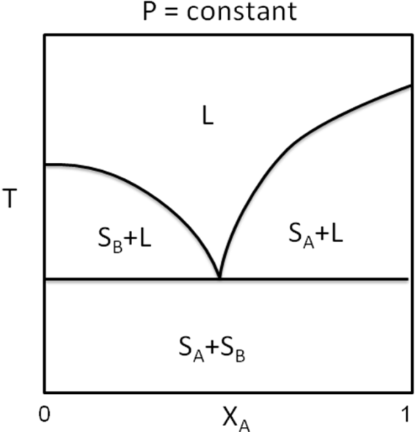
Solid –Liquid Equilibrium
Eutectic point at intersection
Congruent point at the highest temperature

Slide 19
Solid-Liquid Equilibrium
P = constant
S.S: solid solution
T_{a}
S.S: solid solution
L
L
L+S_{B}
L+S.S_{a}
L+S.S_{b}
T_{b}
L+S.S
T
S.S
S.S_{a}
S.S_{b}
E
S.S_{a}+S.S_{b}
S.S+S_{B}
x_{B}
x_{B}
at T_{a}
(No equilibrium equation for component A)

Slide 20
Solid – Liquid Equilibrium
For a component at equilibrium in liquid phase and solid solution phase
For a component at equilibrium in liquid phase and pure solid phase

Slide 21
(Continue)
Where T_{mi} is the melting point, L_{mi} is the latent heat of melting,
, γis and Γis are the activity coefficients in liquid and
solid phase, respectively. All the above quantities are for component i.

Slide 22
Chemical Reaction Equilibrium
A general reaction
aA + bB + →cC + dD + or
At reaction equilibrium in terms of chemical potential of component i.
Define chemical equilibrium constant

Slide 23
Continue
For gas phase reaction
For liquid phase reaction
For ideal gas reaction
For ideal liquid phase reaction
(Under the standard state is chosen at 1 atm)
(The standard state is the fugacity of pure liquid i at the system temperature and 1 atm)

Slide 24
Mathematical Model of a Distillaltion Column (MESH Equations)
Material Balance equation of component i on a tray
i = 1,2,…n
j = 1,2,…m
Equilibrium equation
Summation equation
j = 1,2, …m
Energy balance equation on a tray
j=1,2,….m

Slide 25
Recommended Equations of State (EOS)
Low pressures, no components that associate: Ideal gas mixtures
Low pressure for a mixture that contains an associating component:
Two-term virial equation (HOC model)
Elevated pressures for a vapor mixture that contains hydrocrbons,
nitrogen, oxygen, carbon dioxide, and/or other inorganic gases (but
not HF): Peng-Robinson EOS or Soave EOS with van der Waals
one-fluid mixing rules.
Elevated pressures for a vapor mixture that contains one or
more polar and/or associating compounds: Peng-Robinson EOS
or Soave EOS with the excess Gibbs energy-based mixing rules
and the appropriate activity coefficient model.

Slide 26
Recommended Activity Coefficient Models
Nonpolar + nonpolar: Margules, van Laar, Wilson, UNIQUAC, NRTL
Nonpolar + weakly polar: Margules, van Laar, Wilson, UNIQUAC, NRTL
• Nonpolar + strongly polar: UNIQUAC, NRTL, Wilson
Weakly polar + weakly polar: UNIQUAC, NRTL, Wilson
Weakly polar + strongly polar: UNIQUAC, NRTL, Wilson
Strongly polar + strongly polar: UNIQUAC, NRTL, Wilson
Water + nonpolar or weakly polar: (LLE) UNIQUAC, NRTL
Water + strongly polar: UNIQUAC
Solutions containing carboxylic acids: Wilson (for miscible systems) and
UNIQUAC, NRTL (for partially miscible systems)
Solutions containing polymers: Flory-Huggins model
Solutions containing ionizable salts, strong acids, or bases: Extended
Debye-Huckel model

Slide 28
Thermodynamic Properties of Pure Fluids from Literature
• NIST Chemistry Webbook (National Institute of Standards and Technology, USA)
• – http://webbook.nist.gov/chemistry/
• “TRC Thermodynamic Tables, Hydrocarbons”, Thermodynamics
Research Center, The Texas A&M University System, College
Station, TX.
• “TRC Thermodynamic Tables, Non-Hydrocarbons”, Thermodynamics
Research Center, The Texas A&M University System, College
Station, TX.
• Reid, R.C.; Prausnitz, J.M.; Poling, B.E., “The Properties of Gases and
Liquids,” 4th ed., McGraw-Hill, NY (1987).
• Poling, B.E.; Prausnitz, J.M.; O’Connell, J.P., “The Properties of
Gases and Liquids,” 5th ed., McGraw-Hill, NY (2001).

Slide 29
Phase Equilibrium and OtherThermodynamic Properties of Mixtures from Literature
DECHEMA-- Chemistry Data Series
Vol. I Vapor-Liquid Equilibrium Data Collection
Vol. II Critical Data of Pure Substances
Vol. III Heats of Mixing Data Collection
Vol. IV Recommended Data of Selected Compounds and Binary Mixtures
Vol. V Liquid-Liquid Equilibrium Data Collection
Vol. VI Vapor-Liquid Equilibria for Mixtures of Low Boiling Substances
Vol. VIII Solid-Liquid Equilibrium Data Collection
Vol. IX Activity Coefficients at Infinite Dilution
Vol. X Thermal Conductivity and Viscosity Data of Fluid Mixtures
Vol. XI Phase Equilibia and Phase Diagrams of Electrolytes
Vol. XII Electrolyte Data Collection
Vol. XIV Polymer Solution Data Collection

Slide 30
VLE Data of Mixtures from Literature Volume 1: Vapor-Liquid Equilibrium Data Collection J. Gmehling, U. Onken, W. Arlt, P. Grenzhauser, U. Weidlich, B. Kolbe, J. Rarey
Part title and year of publish
1 Aqueous-Organic Systems, 1991
1a Supplement 1, 1998
1b Supplement 2, 1988
2a Alcohols ,986
2b Alcohols and Phenols, 1990
2c Alcohols Supplement 1, 2001
2d Alcohols and Phenols Supplement 2, 1982
2e Alcohols and Phenols Supplement 3, 1988
2f Alcohols and Phenols Supplement 4, 1990
3/4 Aldehydes, Ketones, Ethers, 1979
3a Aldehydes, Supplement 1, 1993
3b Ketones, Supplement 1, 1993
4a Ethers, Supplement 1, 1996
4b Ethers, Supplement 2, 1999

Slide 31
VLE Data of Mixtures from Literature Volume 1: Vapor-Liquid Equilibrium Data Collection J. Gmehling, U. Onken, W. Arlt, P. Grenzhauser, U. Weidlich, B. Kolbe, J. Rarey
5 Carboxylic Acids, Anhydrides, Esters, 2001
5a Carboxylic Acids, Anhydrides, Supplement 1, 2002
5b Esters, Supplement 2, 2002
6a Aliphatic Hydrocarbons C4-C6 (2nd Ed. with minor changes), 1997
6b Aliphatic Hydrocarbons C7- C18 (2nd Ed. with minor changes), 1997
6c Aliphatic Hydrocarbons Supplement 1, 1983
6d+e Alipatic Hydrocarbons C4- C30, 1999
7 Aromatic Hydrocarbons (2nd Ed. with minor changes), 1997
7a/7b Supplement 1, 2000
8 Halogen, Nitrogen, Sulfur and other Compounds, 1984
8a Halogen, Nitrogen, Sulfur and other Compounds, Supplement 1, 2001

Slide 32
Conclusion
The phase equilibrium estimation is the primary step for process
design, process simulation, process control, and process operation.
Without an accurate phase equilibrium estimation will be impossible
for having a complete chemical plant for producing the desired
products.

Slide 33
Thank You

